Slide 1
Set up Golang Environment on Windows
Date of completing this PPT file: 2020/3/8

Slide 2
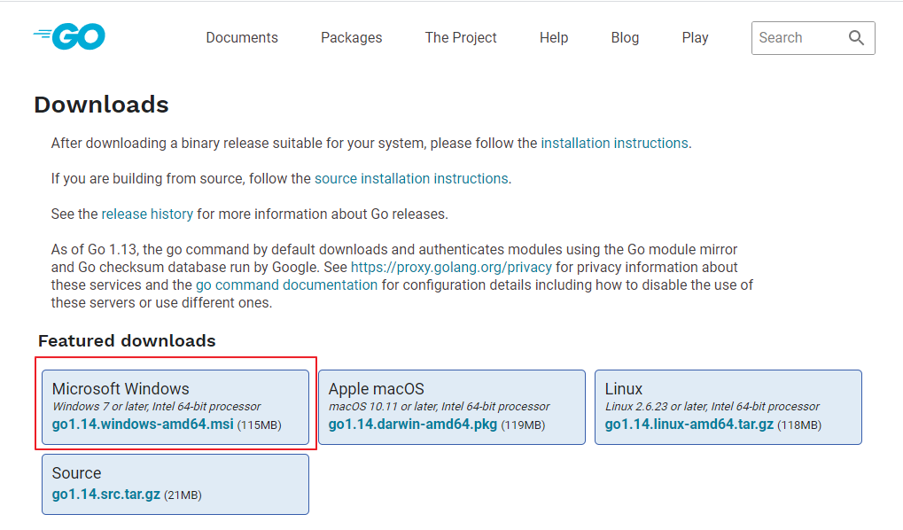
Download Golang and Install it
https://golang.org/dl/

Slide 3
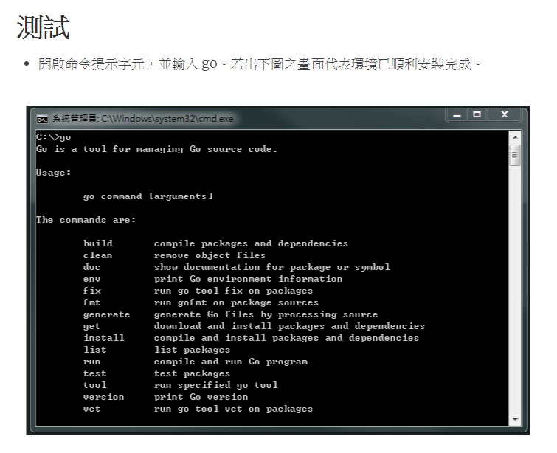
Test

Slide 4
What did Golang installation file do?
Install Golang
Set up some environment variables:
Add new current user environment variable %GOPATH% and set it’s value as %USERPROFILE%\go,
you can open “cmd” and type ECHO %GOPATH% to check it’s setting.
Set your current user environment variable %Path% append %USERPROFILE%\go\bin,
you can open “cmd” and type ECHO %Path% to check it’s setting.

Slide 6
Install Golang related packages
You must execute this .bat file as Administrator

Slide 7
Download and Install VS Code
https://code.visualstudio.com/

Slide 9
Reference
https://oranwind.org/go-ide-visual-studio-code/

